Slide 1
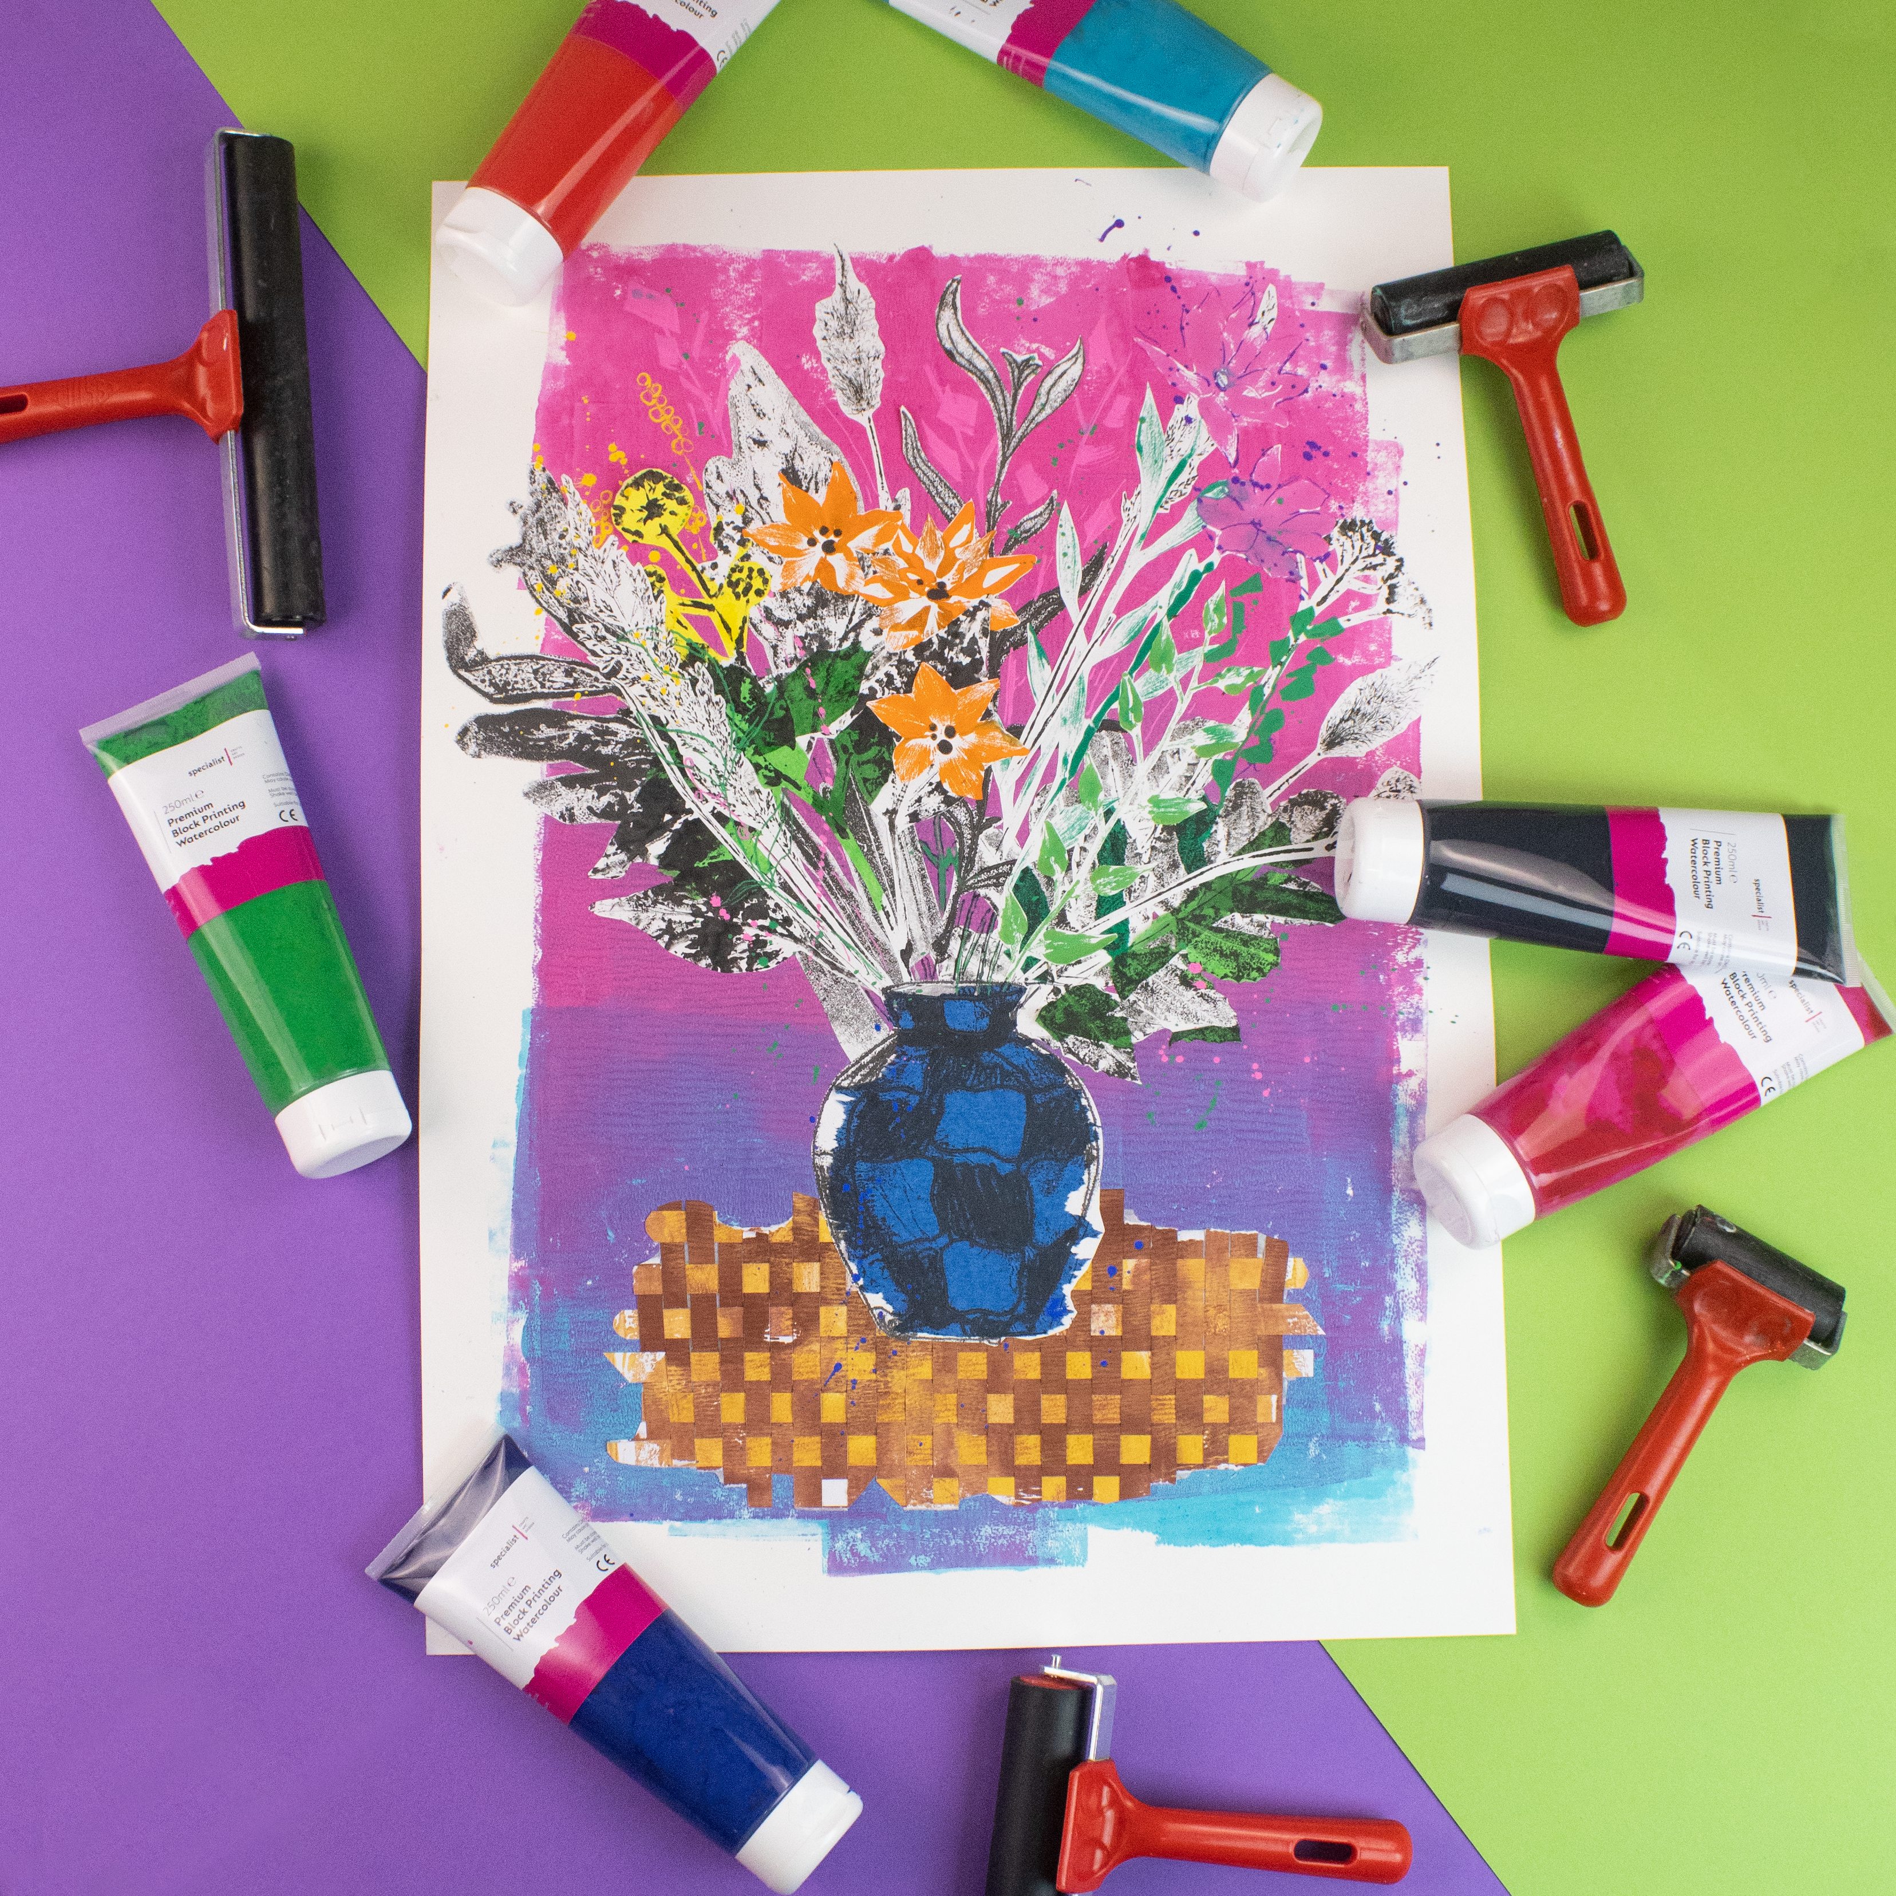

HOW TO GUIDE
Experimental
Botanical
Monoprint Collage
Bring monoprinting techniques together to create a colourful botanical still life.
CLASSROOM-READY PROJECT

Slide 2
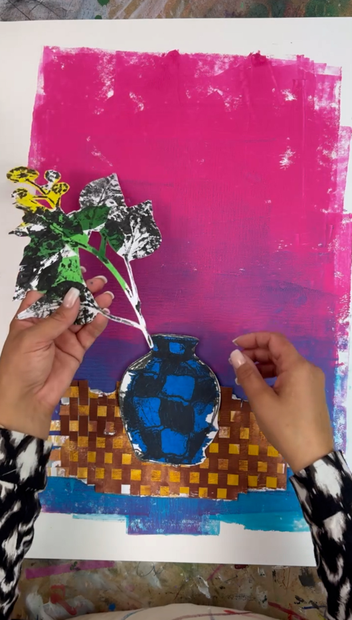
Build one artwork from many printmaking processes
Create individual plants and a vase, then cut, weave, layer and
assemble them into a lively botanical still life.
Additive monotype
Subtractive monotype
Trace monoprinting
Texture transfer
Chine-collé
Split fountain rolling
Collage & paper weaving

Slide 3
What you’ll need
Monoprinting plate
Watercolour block-printing inks
Gather everything before you begin so inks, papers and plant references are ready for each process.
Choose a colour palette that gives you both vivid focal points and quieter areas of contrast.
Roller
Cartridge paper
Brushes and mark-making tools
Plants, flowers or reference images
Vase photograph or image
Coloured tissue paper
Pencil or drawing tool
Scissors
PVA glue

Slide 4
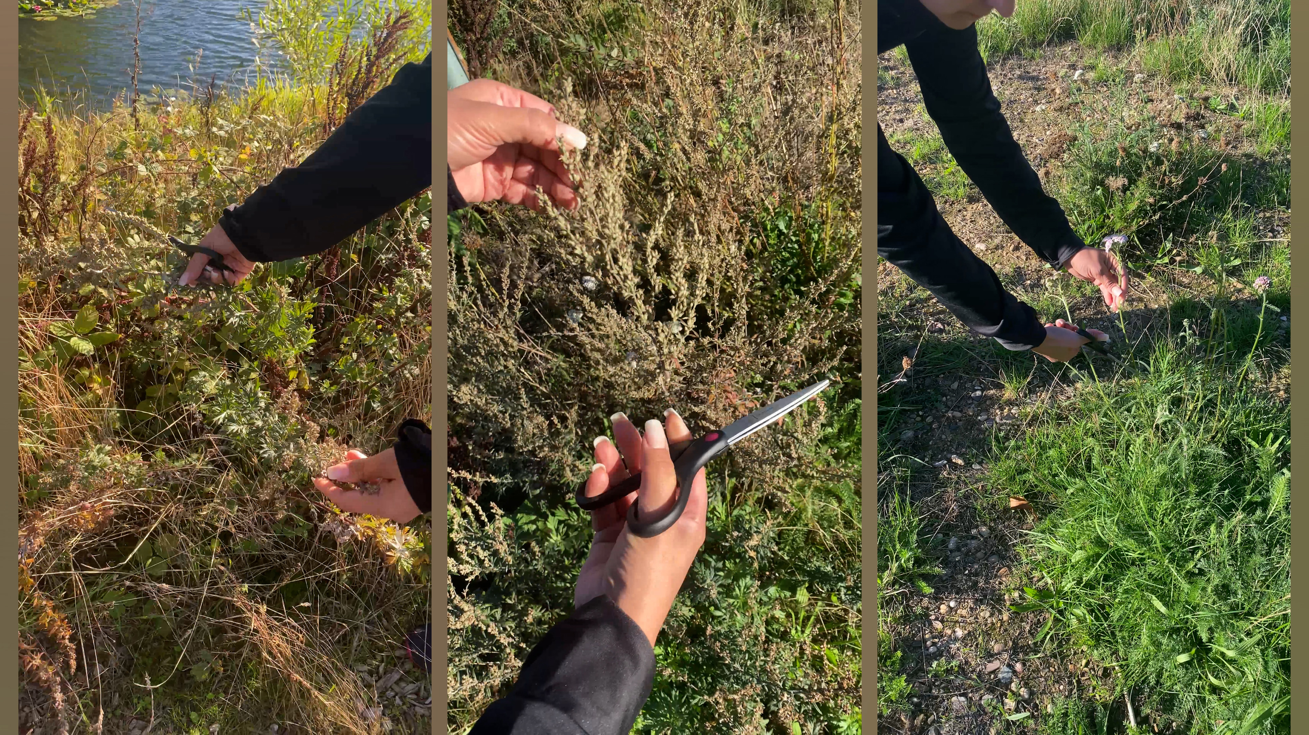
Choose your botanical references
STEP 1
Start by gathering a selection of plants, leaves, flowers and stems to inspire your prints.
Look for a mixture of shapes and textures, broad leaves, delicate stems, flowers, seed heads and unusual silhouettes will give you plenty of variety when you start building your final arrangement.
Work directly from real plants or use your own botanical photographs and reference images.
TEACHER TIP
Choose varied shapes and textures now; they will make the final arrangement feel richer.

Slide 5
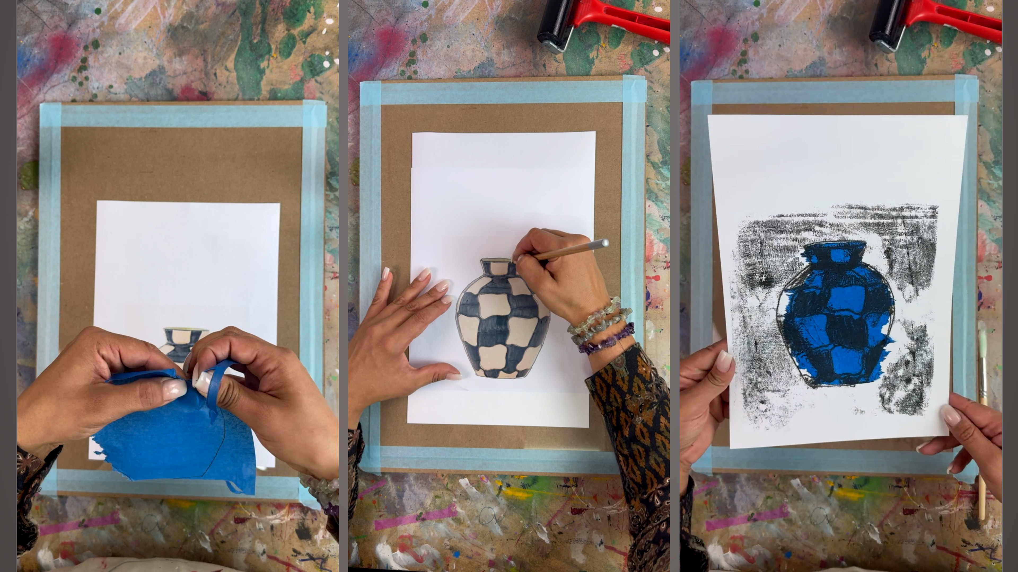
Trace-print the vase with chine-collé
STEP 2
Tape your monoprinting plate to a board or the table to secure it. Introduce chine-collé using lightweight coloured paper to add areas of colour and texture to the vase. Roughly tear the shape of the vase out of the coloured tissue paper and stick onto the paper.
To create the vase using trace monoprinting.
Place your paper with the coloured tissue paper , face down over a thinly inked printing plate, then lay the image of your vase over the top and trace the vase, allowing the pressure from your drawing tool to pick up the ink underneath. Remember not to accidently rest your hand on the paper. Lift to reveal the trace of your vase.
TEACHER TIP
Keep hands off the paper while tracing or stray pressure will pick up unwanted ink.

Slide 6
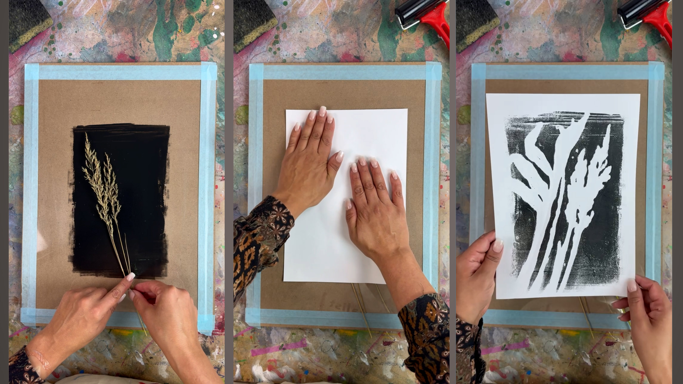
Create botanical monoprints
STEP 3
Now create a collection of individual flowers, leaves and plants using different monotype printing techniques. Try additive monotype printing by applying ink directly to the plate with brushes and mark-making tools to build your plant shapes.
For a different effect, use subtractive monotype printing. Cover the plate with ink and remove selected areas to reveal leaves, stems, highlights and details.
You can also experiment with texture transfer, using real leaves and textured materials to introduce organic marks and patterns.
Create more plants than you think you'll need - having plenty to choose from will give you more freedom when you arrange your final composition.
TEACHER TIP
Print more elements than you expect to use. Choice makes arranging far easier later.

Slide 7
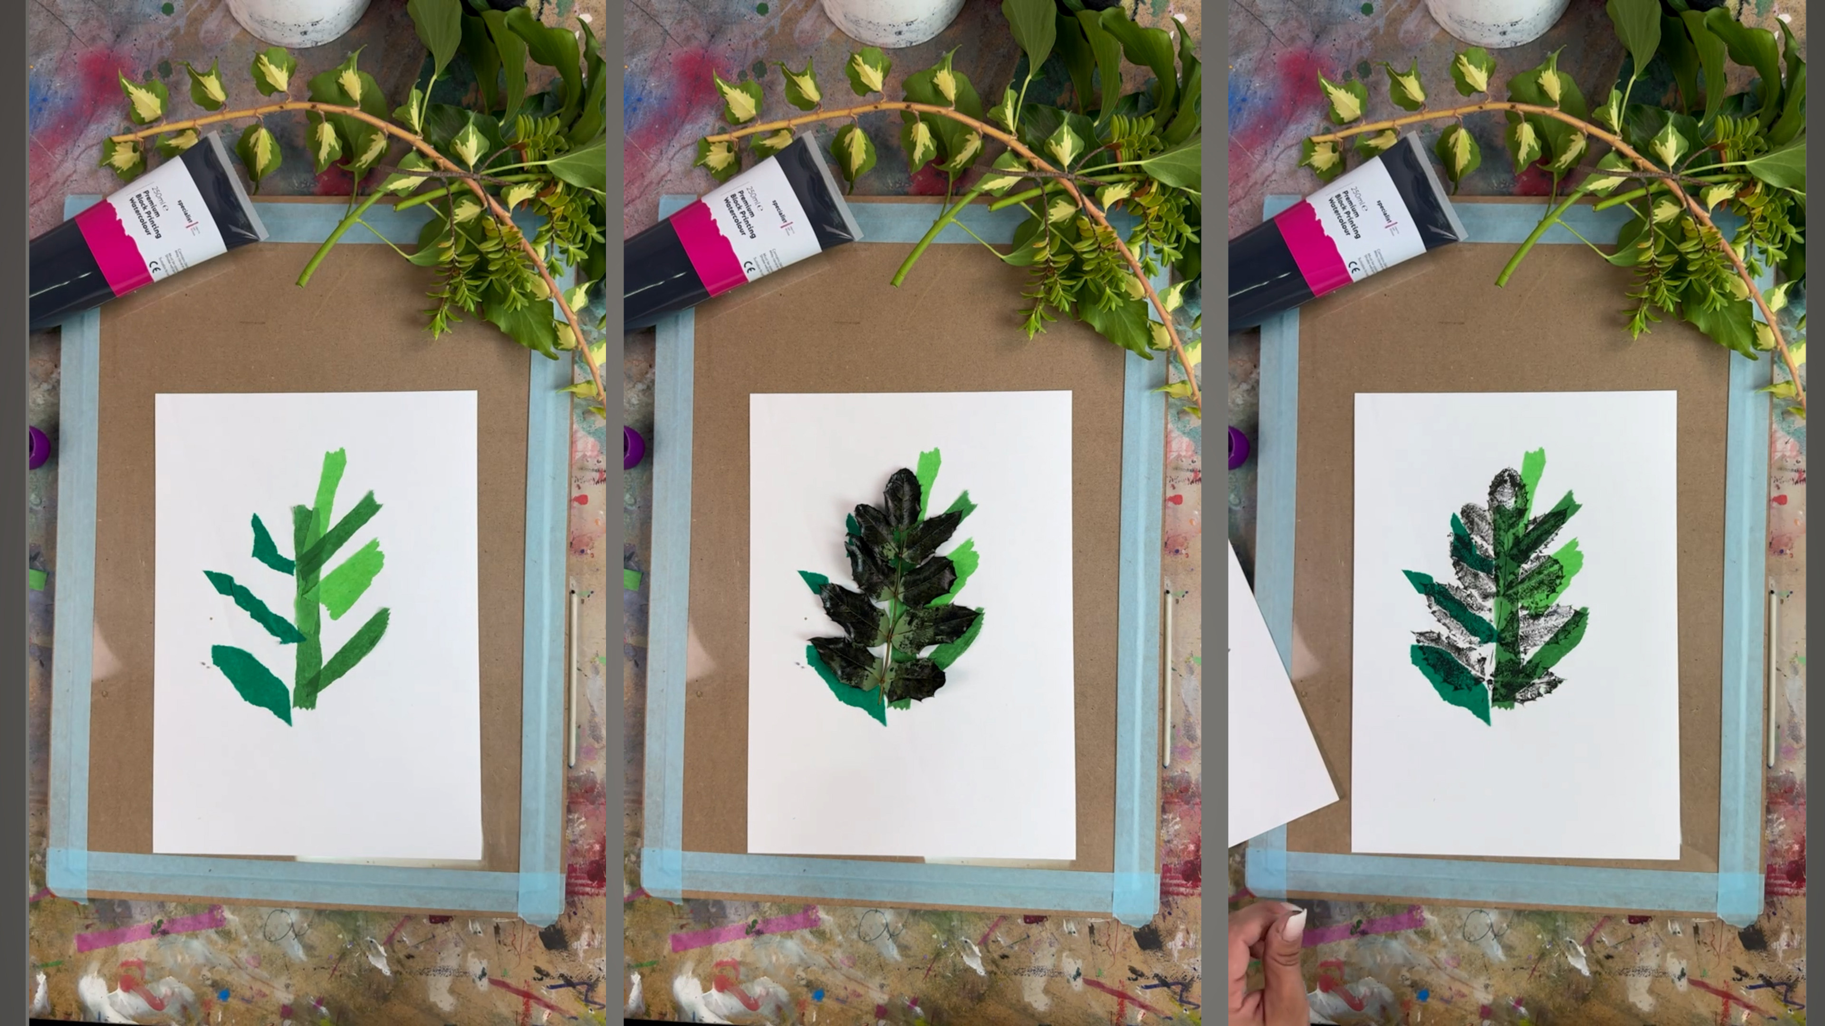
Add colour with chine-collé
STEP 4
Use chine-collé on some of your botanical prints to introduce splashes of colour.
Try adding coloured paper to individual flowers, leaves or details rather than using it everywhere.
Keeping some of your botanical prints black and white creates contrast against the brighter areas and helps the different layers stand out when they're brought together.
TEACHER TIP
Small, deliberate colour accents often have more impact than covering every print.

Slide 8
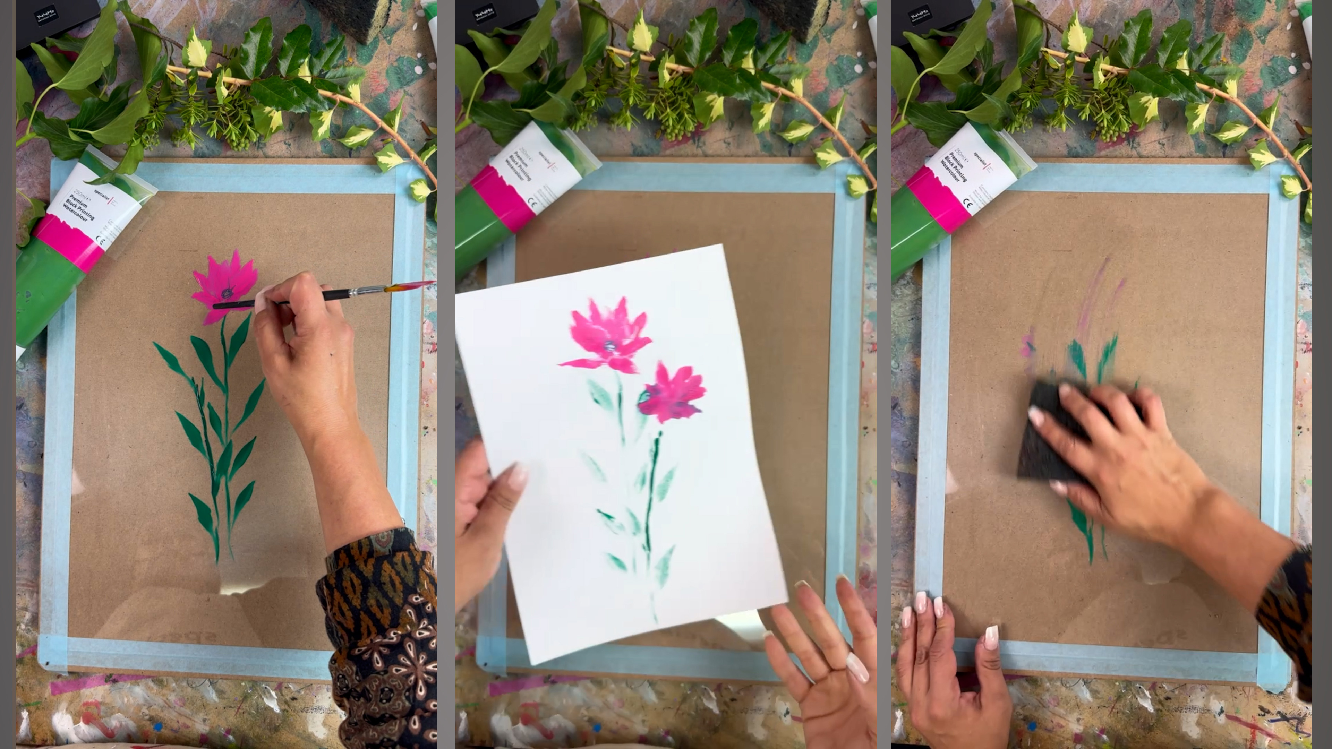
Paint additive monotype flowers
STEP 5
Create more botanical elements using additive monotype printing. Paint flowers, leaves and stems directly onto the printing plate, experimenting with different brushes, tools and marks before taking each print.
Build up a collection of different plant shapes, floral forms, colours and textures. Don’t worry about creating a complete arrangement at this stage, these individual prints will be cut out and combined later to create your final botanical composition.
Try varying the scale and style of your prints so you have plenty of contrasting elements to choose from.
TEACHER TIP
Focus on a collection of contrasting elements rather than one finished arrangement.

Slide 9
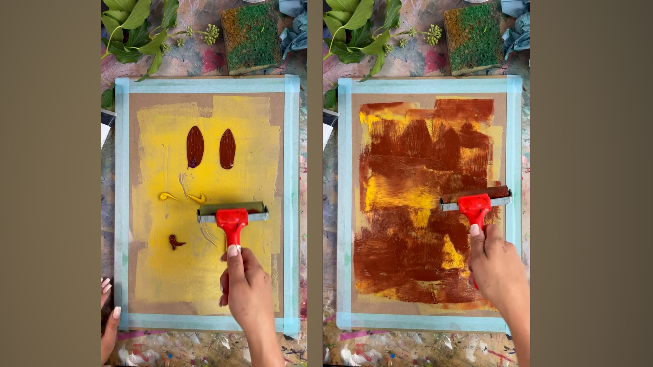
Create papers for the tablecloth
STEP 6
Roll different colours of printing ink roughly across sheets of paper to create your own textured monoprinted papers.
Don't aim for a perfectly smooth finish. Visible roller marks, overlaps and variations in colour will make the woven surface more interesting.
TEACHER TIP
Let the printed sheets dry completely before cutting them into strips.

Slide 10
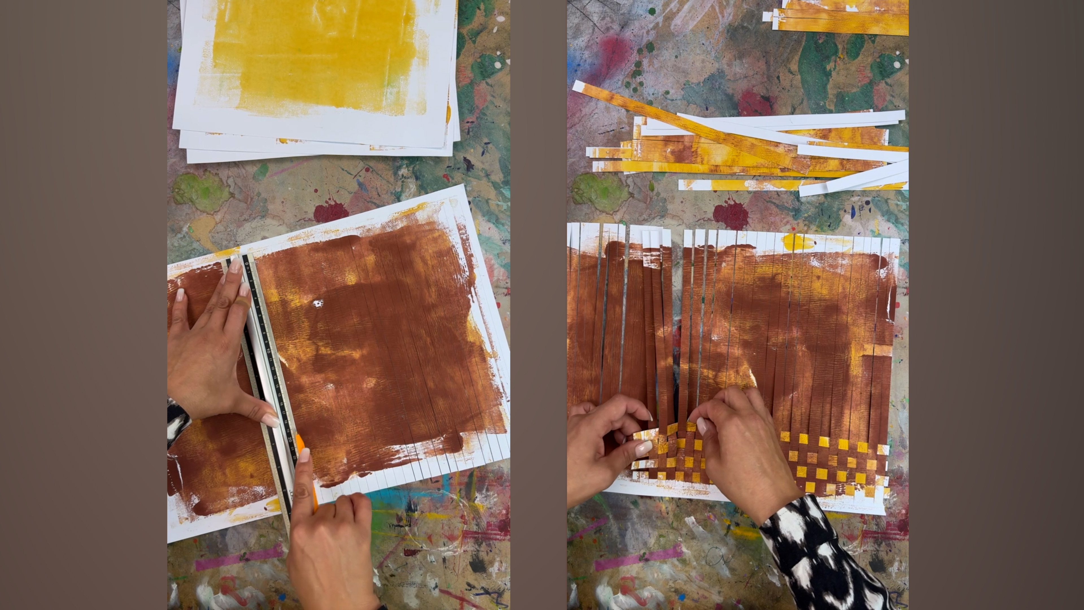
Weave the printed tablecloth
STEP 7
Once dry, cut your textured printed papers for the tablecloth into strips. Take your strips of monoprinted paper and weave them over and under one another to create a simple basket-weave effect.
Mix different colours and tones to create variation across the surface.
Rather than cutting the finished weave into a perfect rectangle, leave some of the strips longer and keep the outside edge irregular. The rough, uneven shape complements the expressive quality of the monoprints.
Once you're happy with the weave, secure the strips together with masking tape on the back.
TEACHER TIP
An uneven outline suits the expressive character of the monoprints better than a perfect rectangle.

Slide 11
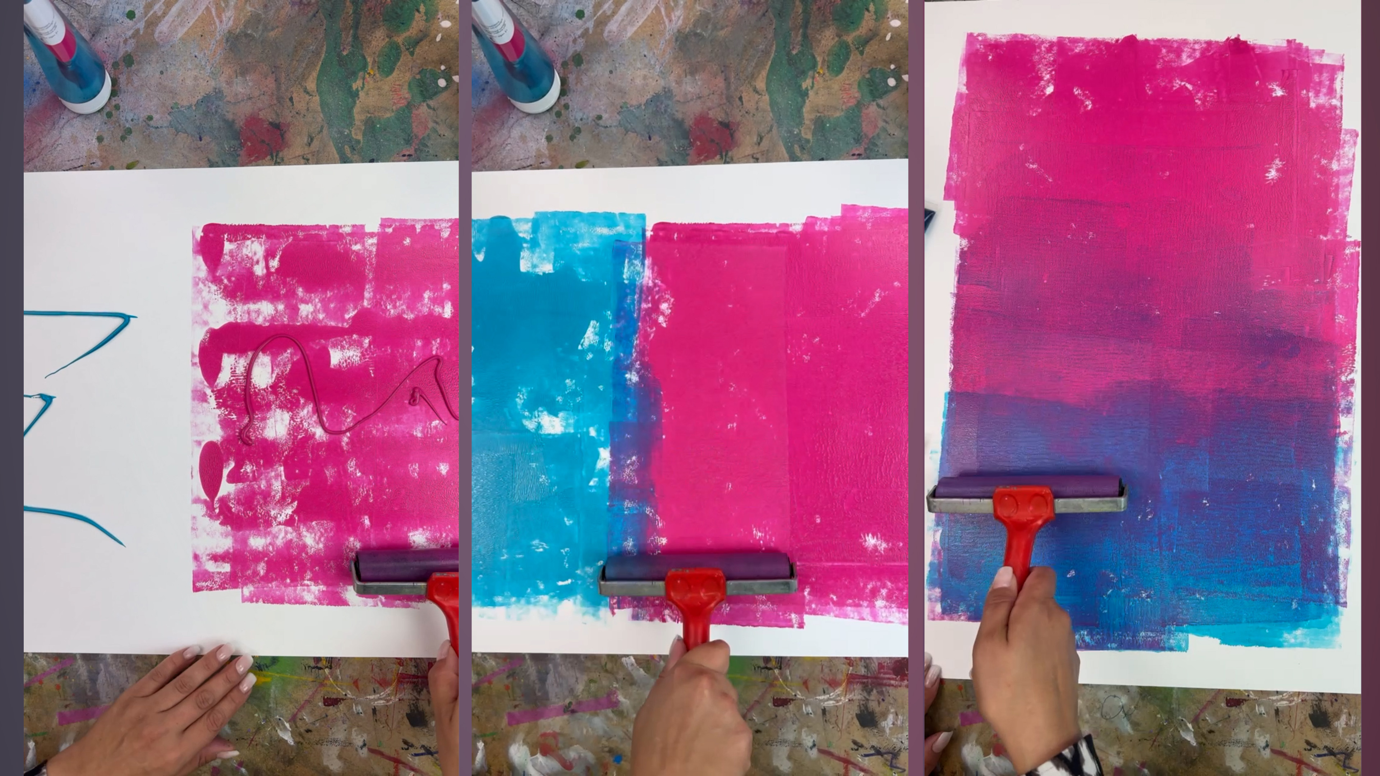
Roll a split fountain background
STEP 8
Next, create a colourful background using split fountain rolling.
Place two colours of printing ink next to one another we've used pink and blue - and gradually work them with your roller so the colours begin to blend where they meet.
Roll the colour across your background paper to create a loose gradient. Allow the edges and roller marks to remain visible rather than trying to create a perfectly finished block of colour. These imperfections become part of the printed surface.
TEACHER TIP
The imperfect printed surface is part of the artwork - do not overwork it.

Slide 12
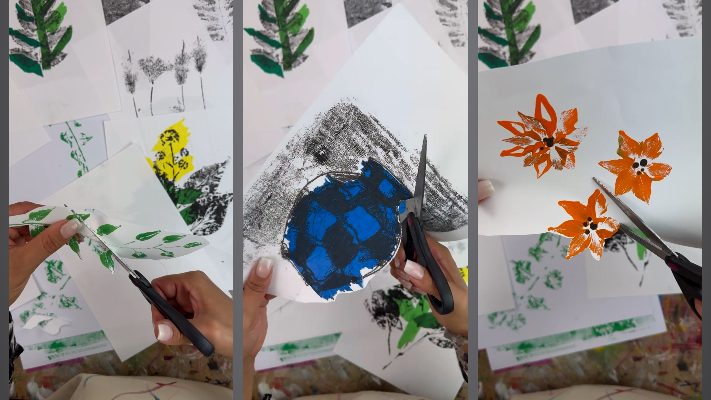
Cut out the printed elements
STEP 9
Once your prints are completely dry, carefully cut around your vase, flowers, leaves and botanical elements.
Don’t worry about cutting every shape too precisely. Leaving some rough, irregular edges helps retain the expressive, handmade quality of the monoprints.
Lay all your cut-out pieces together so you can see the full collection before beginning your composition. Having a variety of different shapes, sizes, colours and textures will give you more freedom when arranging your botanical still life.
TEACHER TIP
Keep a variety of shapes, sizes, colours and textures available for the next stage.

Slide 13
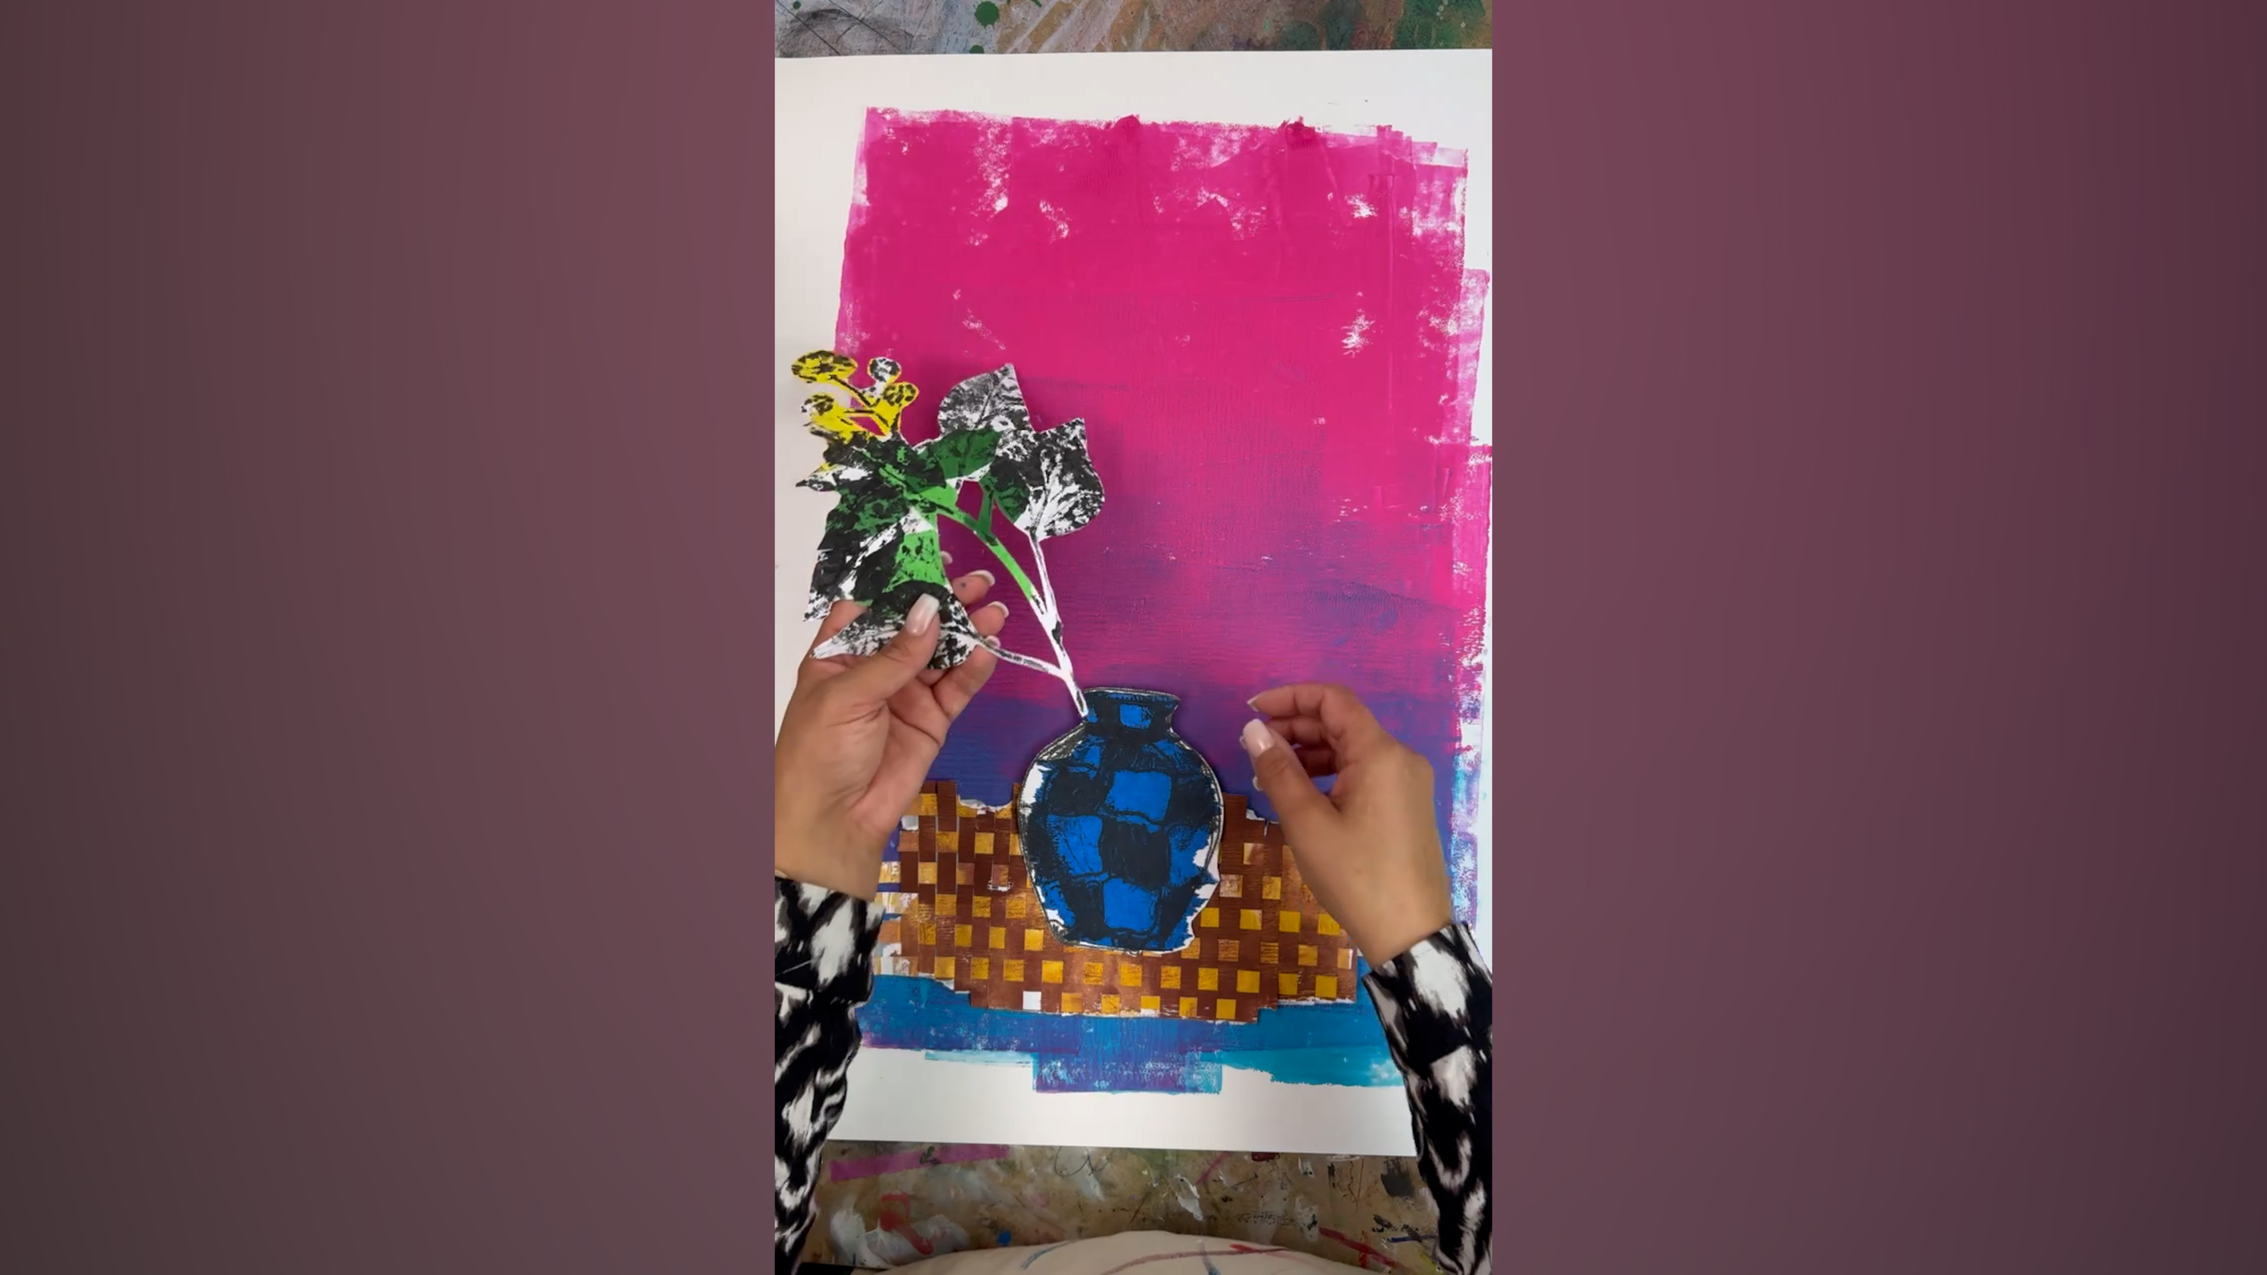
Arrange the botanical collage
STEP 10
Now it's time to bring all your individual prints together.
Position the woven tablecloth first, then add your vase and begin arranging the printed plants, flowers and leaves around it. Don't glue anything yet. Move the pieces around and experiment with different arrangements. Try overlapping plants, changing their heights and allowing stems and leaves to cross over one another. Think about where your strongest colours sit within the composition and balance the black-and-white prints against the brighter chine-collé elements.
Once you're happy with the arrangement, take a quick photograph so you have a reference when you start gluing.
TEACHER TIP
The reference photo will help you rebuild the composition accurately while gluing.

Slide 14
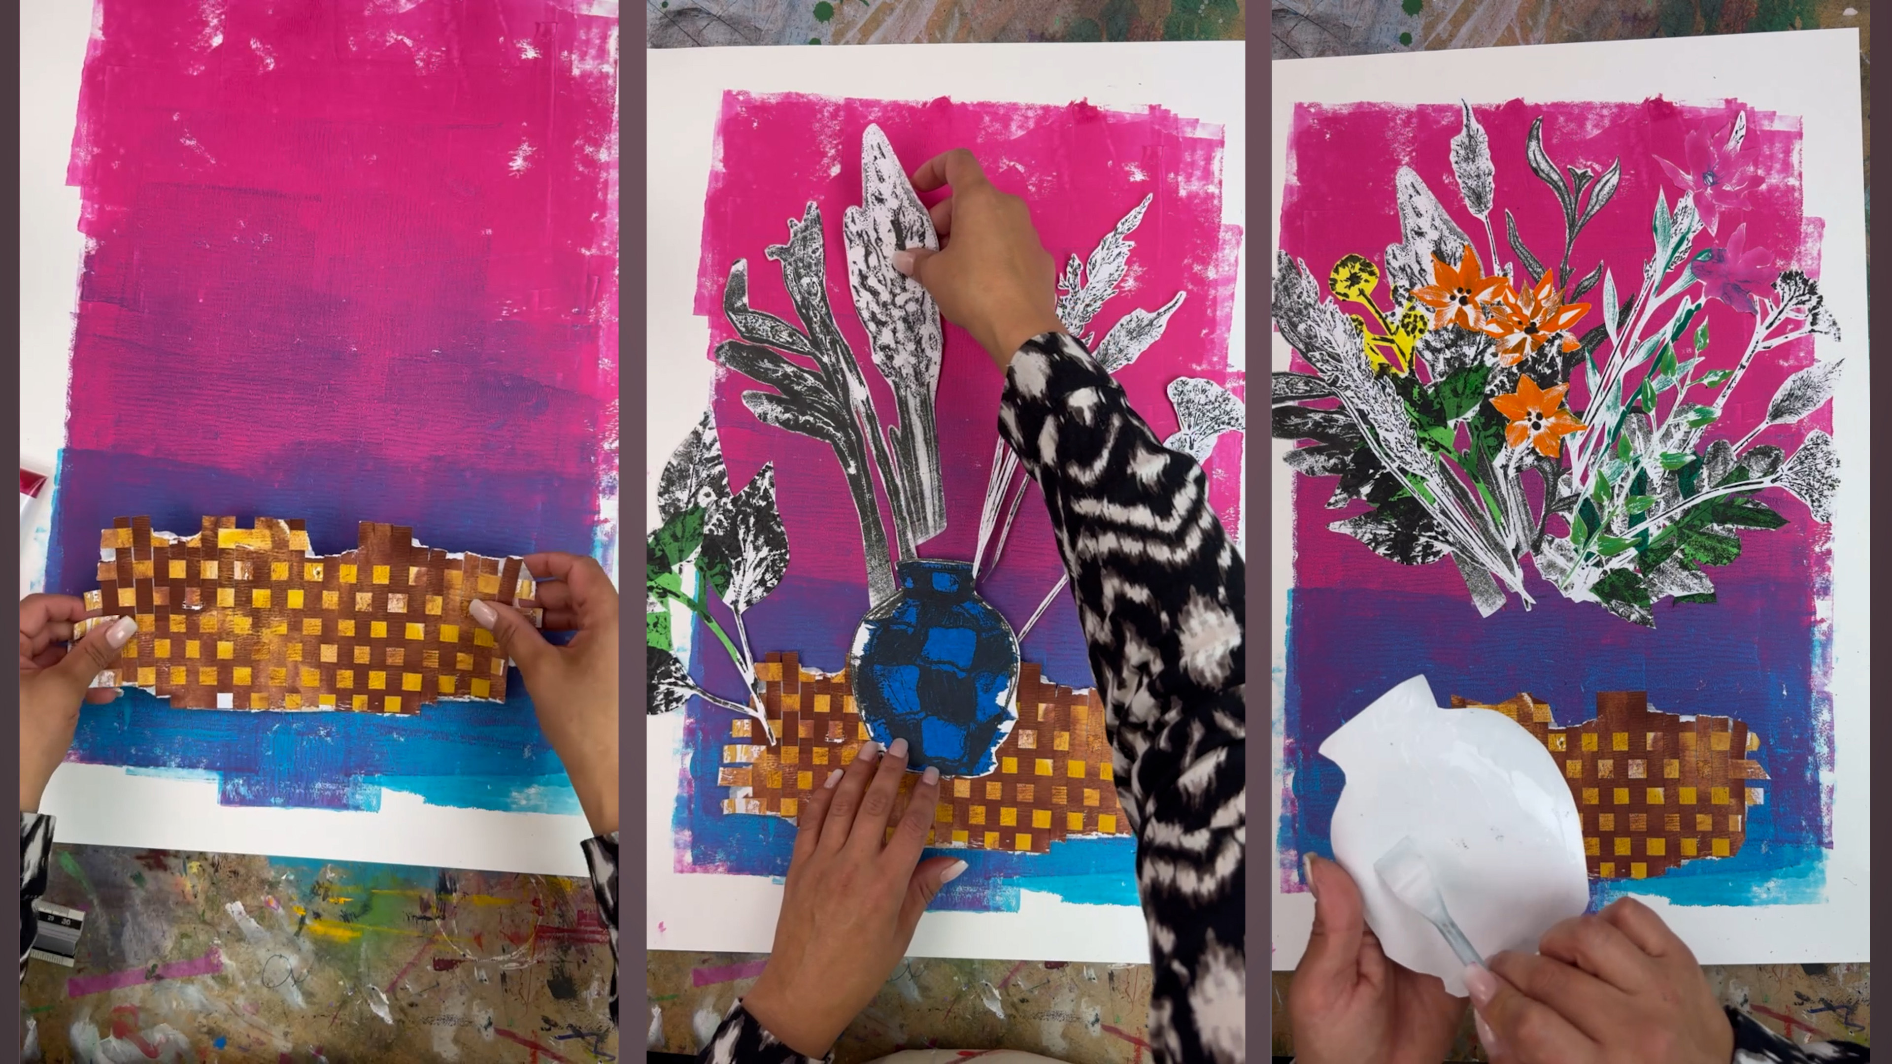
Assemble the final artwork
STEP 11
Start by gluing the woven tablecloth into position, followed by the elements that need to sit furthest back.
Gradually build the botanical arrangement forwards, layering and overlapping your printed plants as you go.
Add the vase in the appropriate layer so that the stems appear to sit naturally inside it.
Take your time. You can continue adjusting individual elements as the composition develops.
TEACHER TIP
Work gradually. You can still adjust individual pieces as the composition develops.

Slide 15
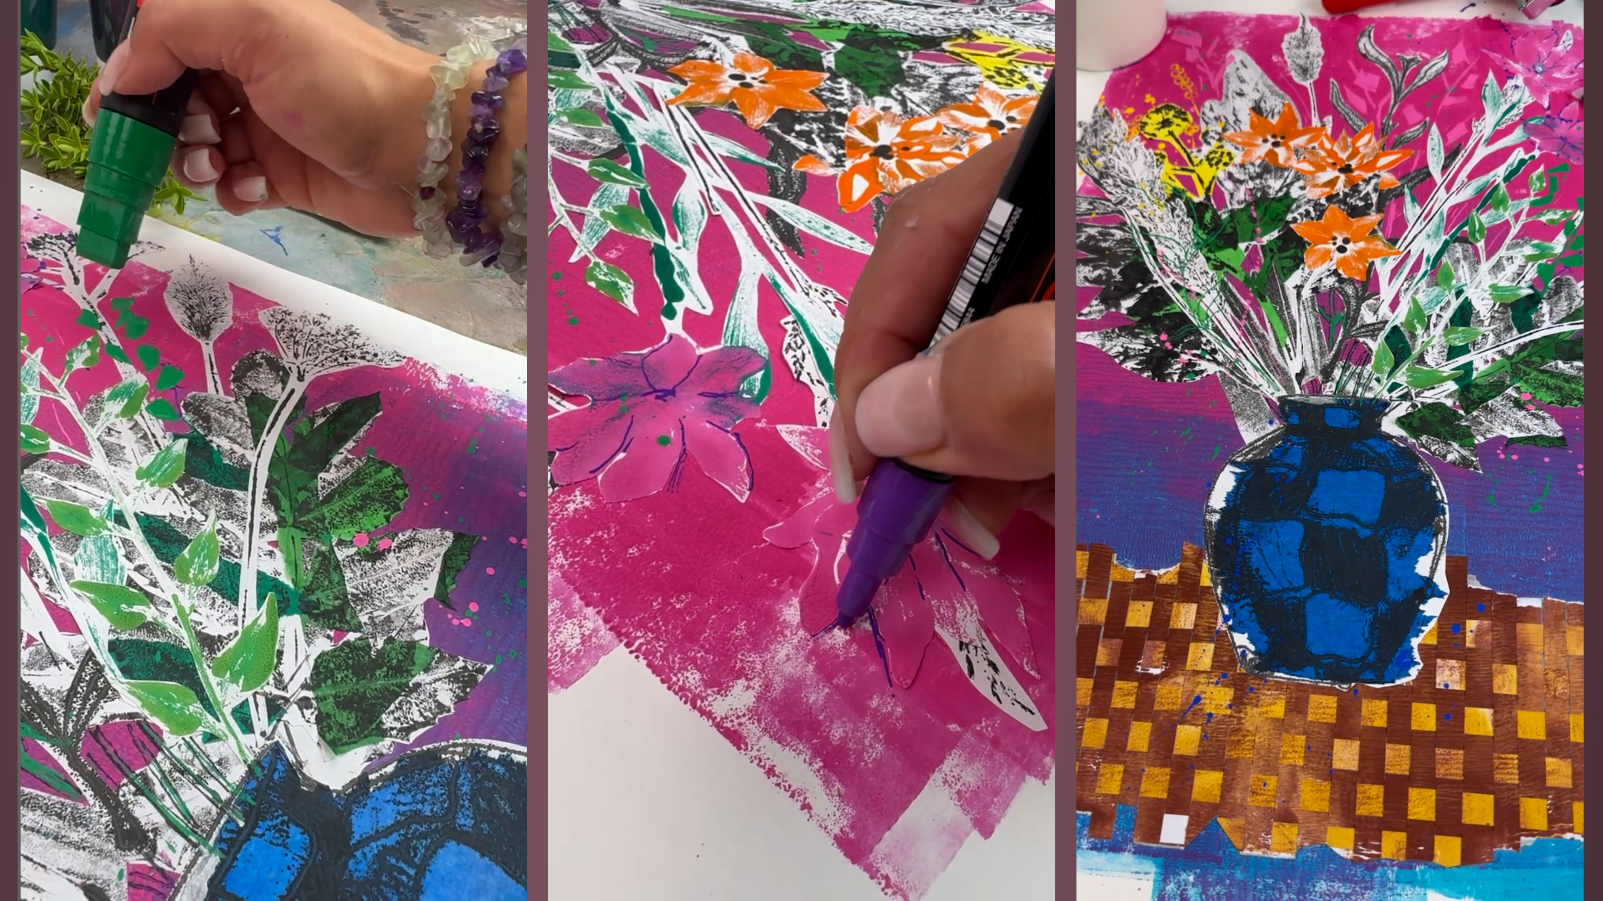
Add the finishing touches
STEP 12
Look at your finished botanical monoprint and decide whether the composition needs anything else.
You might introduce another flower, add a small area of colour or bring in an additional printed texture.
But don't feel that every area needs filling. The contrast between monoprinted marks, cut edges, woven paper, bold colour and areas of white space is part of what gives the finished artwork its character.
TEACHER TIP
Not every gap needs filling, the quieter areas allow the colour and pattern to breathe.

Slide 16
MAKE IT YOUR OWN
Change the ingredients.
Keep the process.
Choose different plants or a new vase
Try another colour palette
Add ghost prints, masks or stencils
Experiment with multi-layer registration
Move beyond the traditional still life
Experiment • combine • develop

