Slide 1
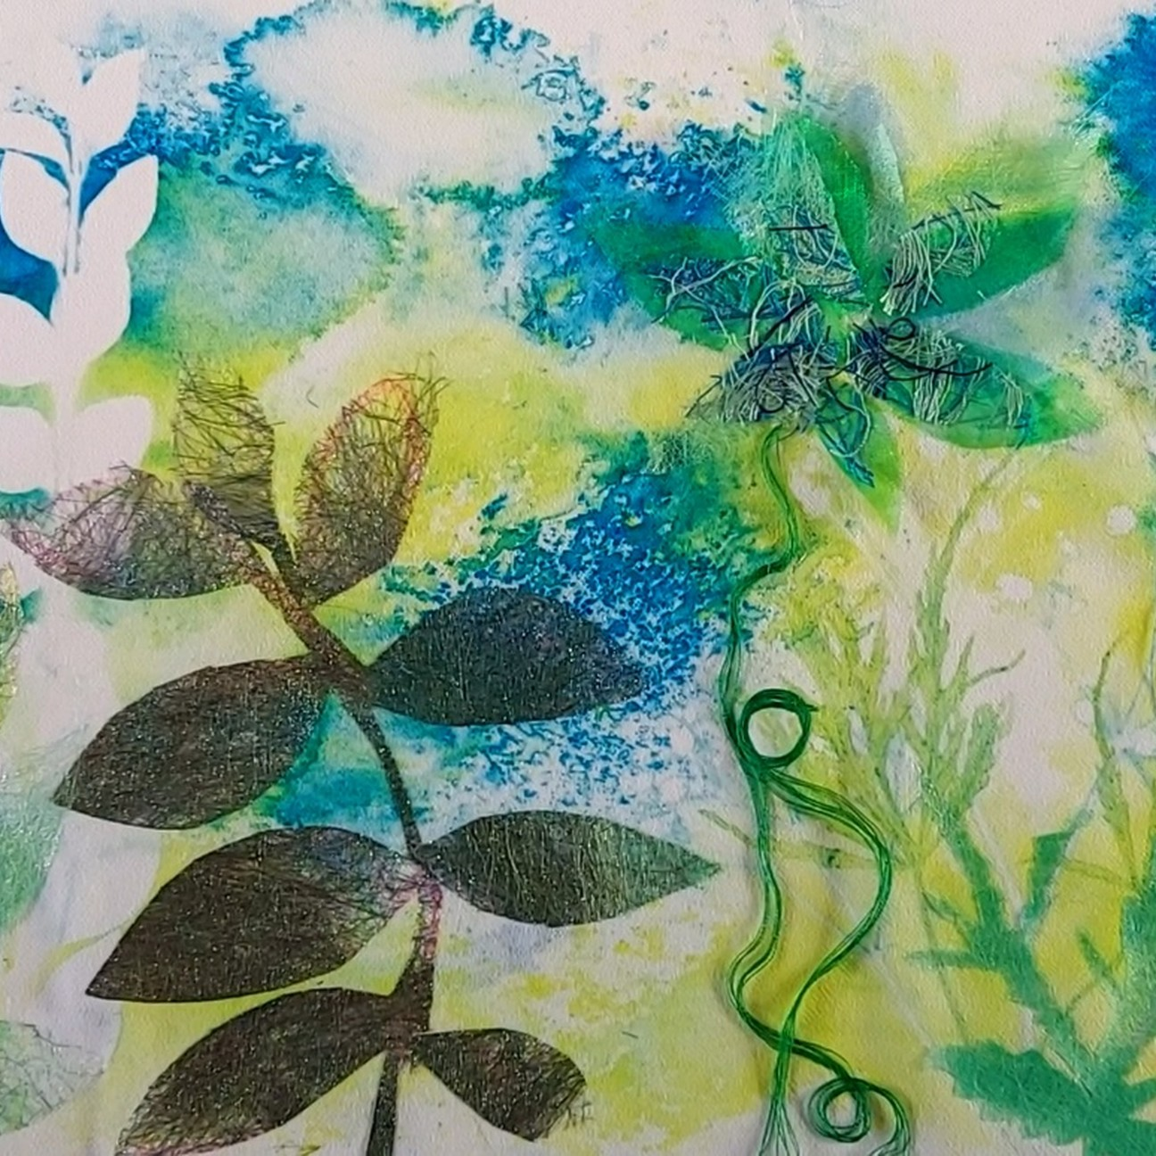

HOW TO GUIDE
Floral Textile
Appliqué with
Angelina Fibres
Create a layered botanical textile using transfer dyes, leaf printing, shimmering fibres and organza.
CLASSROOM-READY PROJECT

Slide 2
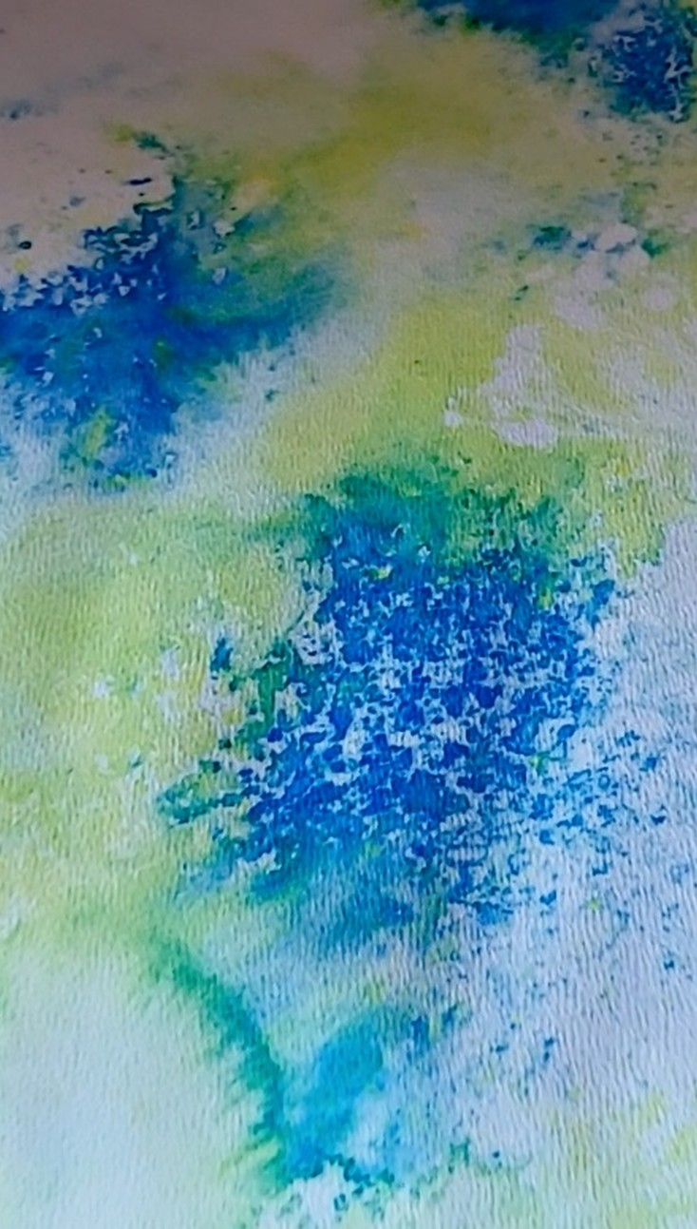
Build a floral design through
experimental textile techniques
Explore heat transfer printing, leaf resist, bonded Angelina fibers and three-dimensional appliqué.
Transfer dye painting
Botanical leaf printing
Heat transfer printing
Leaf resist printing
Angelina fibres bonding
Bonding web appliqué
Organza & thread layering

Slide 3
What you’ll need
Specialist Crafts transfer paints
Crepe de Chine (100% polyester)
Prepare your printing materials, polyester fabric and embellishments before starting.
Flat hog brushes
Crystal organza
Pointed scissors
Fusible Angelina fibres
SureStitch polyester thread
SureStitch bonding web
Four-well palette
Leaves and sketchbook paper
Greaseproof paper

Slide 4
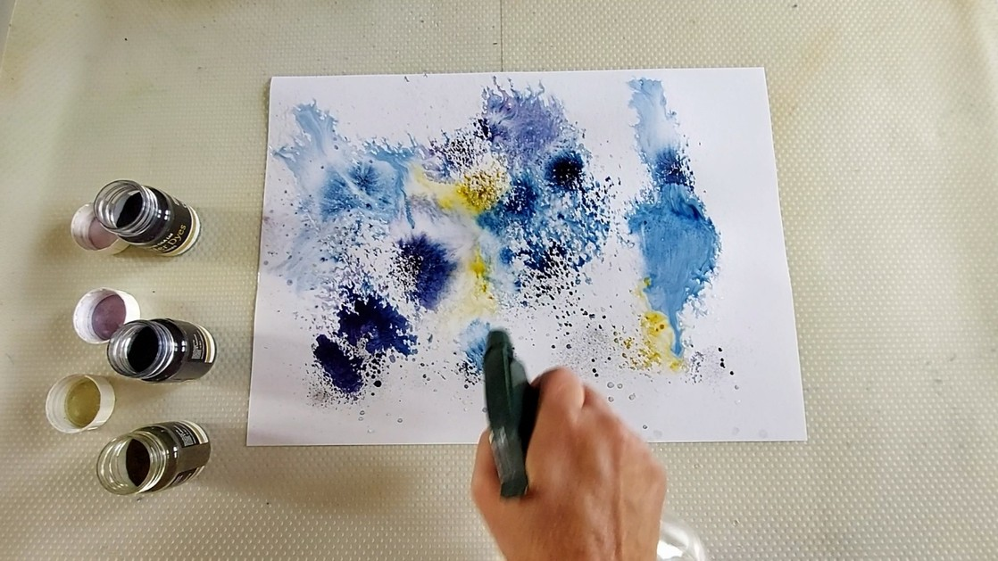
Create your transfer dye background
STEP 1
Place sketchbook paper on your work surface and lightly spray it with water until damp. Flick small amounts of transfer dye onto the paper using the end of a paintbrush. Experiment with different colours, allowing them to spread and blend naturally. Add another light spray of water if areas dry too quickly or need more blending. Leave the paper to dry completely.
TEACHER TIP
Allow the painted paper to dry completely before heat transfer.

Slide 5
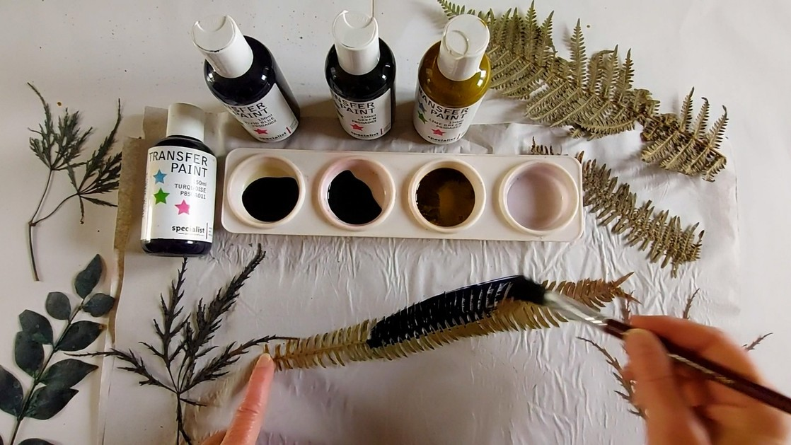
Paint your leaves
STEP 2
While the transfer dye paper dries, choose leaves with interesting shapes and textures, either freshly collected or pressed. Use a smooth, flat brush to coat each leaf with transfer paint. Mix blue and green shades in the palette or blend colours directly on the leaf. Cover evenly and allow to dry. Previously painted leaves can be reused with another coat.
TEACHER TIP
Try a variety of leaf silhouettes and reuse leaves for extra prints.

Slide 6
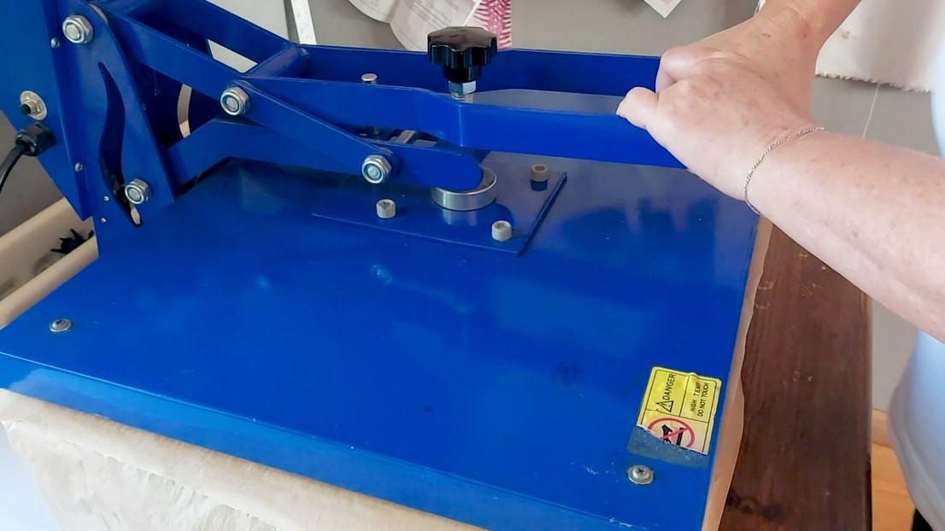
Heat transfer onto fabric
STEP 3
Once your dyed paper is dry, place polyester fabric on the heat press with greaseproof paper underneath. Add leaves or other materials if you want reverse impressions. Place the dyed paper face down against the fabric. Heat press for approximately 20 seconds, as shown in the demonstration, then carefully lift the paper to reveal the transferred background.
TEACHER TIP
Use appropriate heat settings and supervise all heat-press work.

Slide 7
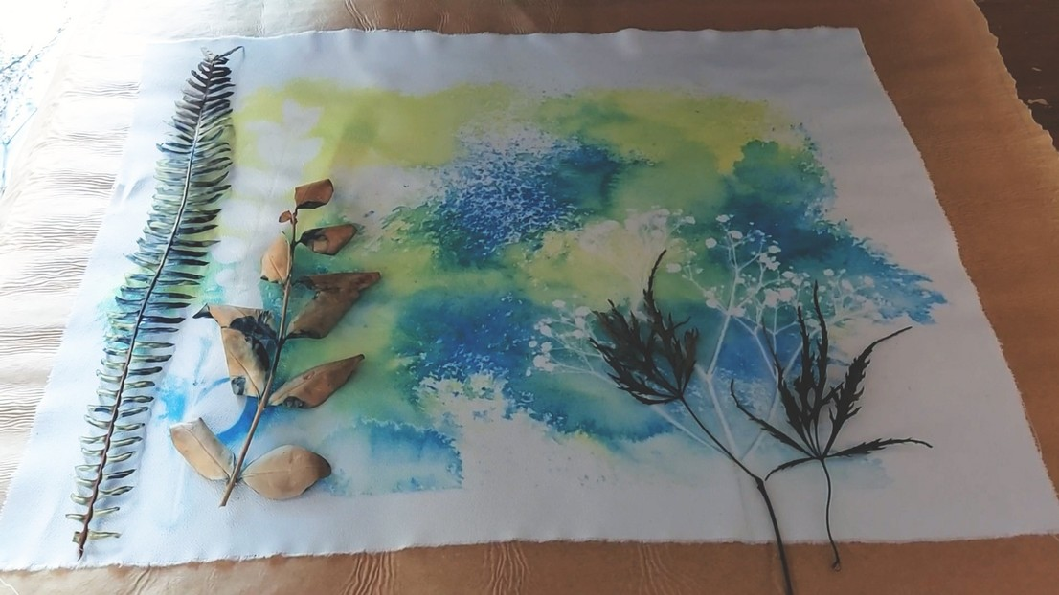
Add your leaf prints
STEP 4
Arrange your dried, painted leaves face down on the printed polyester fabric. Try different positions to create a balanced botanical composition. Cover with greaseproof paper and heat press again to transfer the leaf shapes. Remove the protective paper and leaves to reveal the additional prints.
TEACHER TIP
Test your arrangement before applying heat.

Slide 8
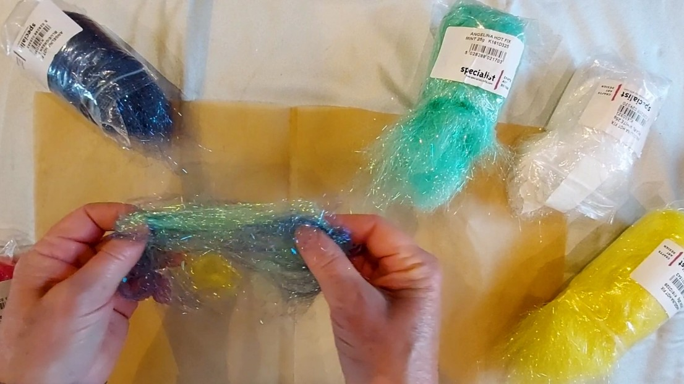
Create Angelina fibre fabric
STEP 5
Choose Angelina fibre colours, working with individual shades or teasing several together. The demonstration combines yellow, green and blue. Spread a thin, even layer on greaseproof paper, cover with another sheet and gently pass a hot iron over the top. The fibres fuse into a lightweight, shimmering fabric. Carefully peel it away from the paper.
TEACHER TIP
Keep fibres thin and evenly spread for more consistent bonding.

Slide 9
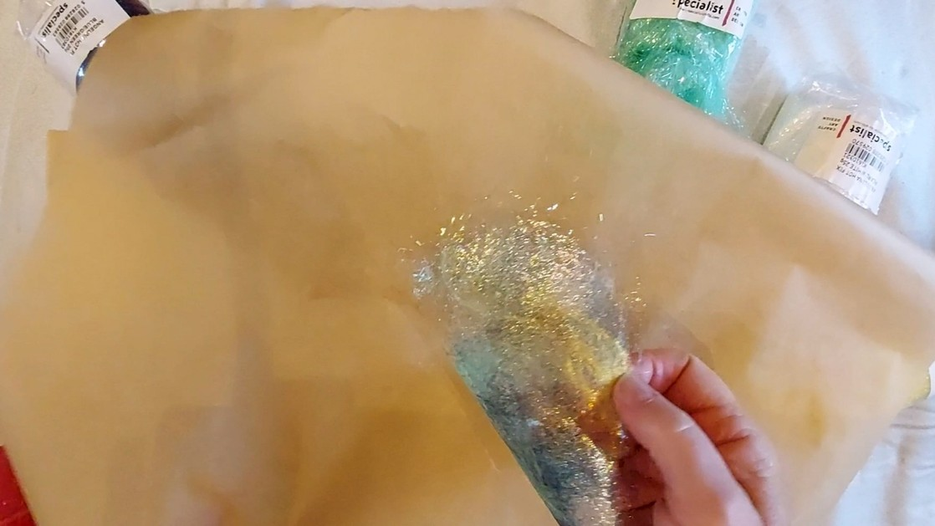
Attach bonding web
STEP 6
Cut bonding web to fit the Angelina fabric and position the fabric on top. Cover with greaseproof paper and gently pass a hot iron across the surface a couple of times. Allow it to cool before peeling away the backing paper. The Angelina fabric now has an adhesive reverse ready for cutting and attaching. You can also experiment with threads, sequins or small fabric scraps.
TEACHER TIP
Let the material cool before removing the backing paper.

Slide 10
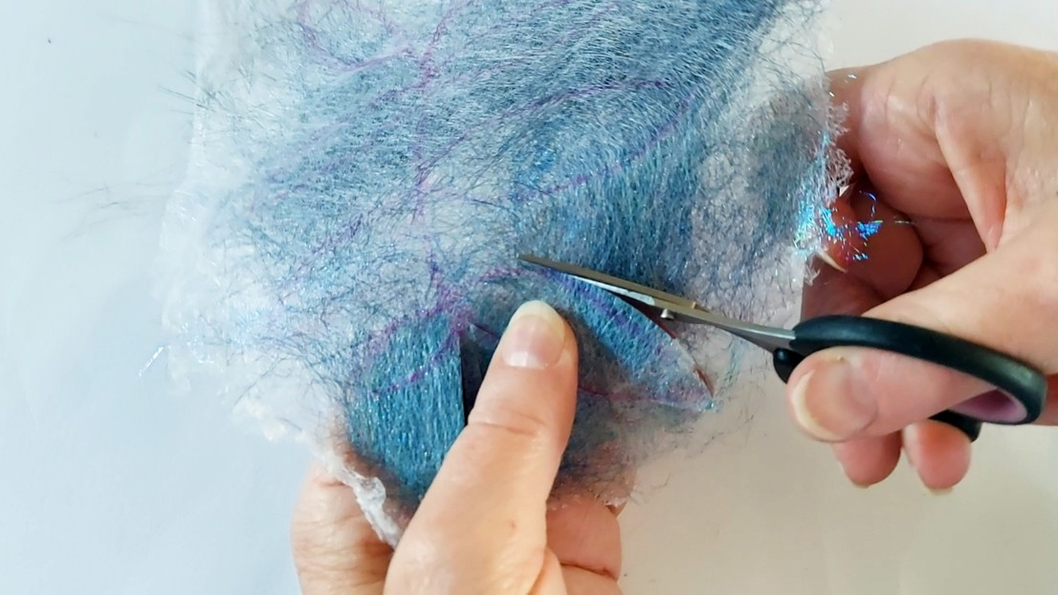
Cut out appliqué shapes
STEP 7
On the adhesive side of your bonded Angelina fabric, lightly draw leaf and stem shapes that complement your printed background. Cut carefully with sharp scissors. Make a larger connected stem with leaves or smaller individual shapes. Keep offcuts for filling gaps and adding details later. Try varying fibre colours, textures and thread combinations.
TEACHER TIP
Save small offcuts: they make useful final embellishments.

Slide 11
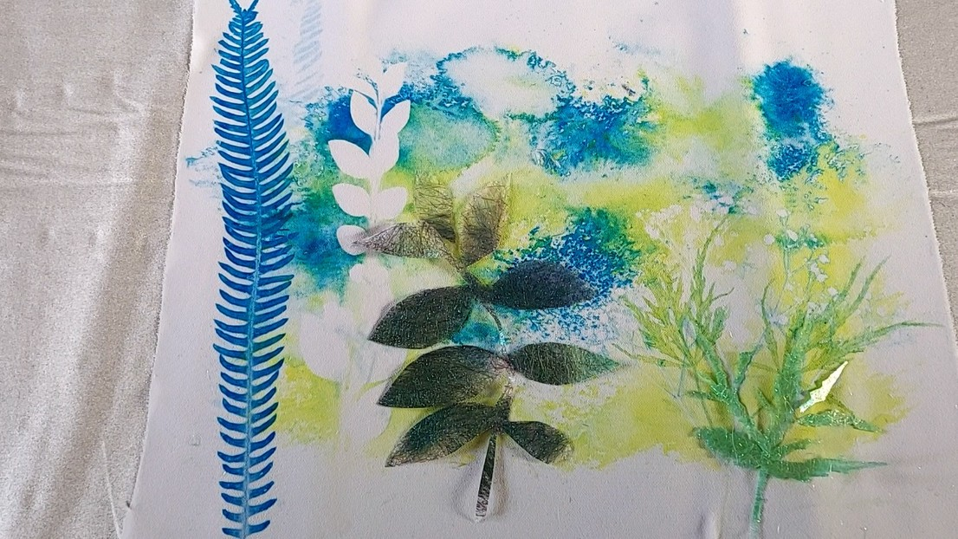
Apply shapes to the fabric
STEP 8
Arrange the cut-out Angelina shapes on the printed background, with the bonding web facing down. Adjust the composition before fixing anything. Cover with greaseproof paper and gently iron across the surface. Lift the paper carefully to check the shapes have bonded. If any sections are loose, cover them and apply a little more heat.
TEACHER TIP
Keep adhesive facing the base fabric and protect with paper.

Slide 12
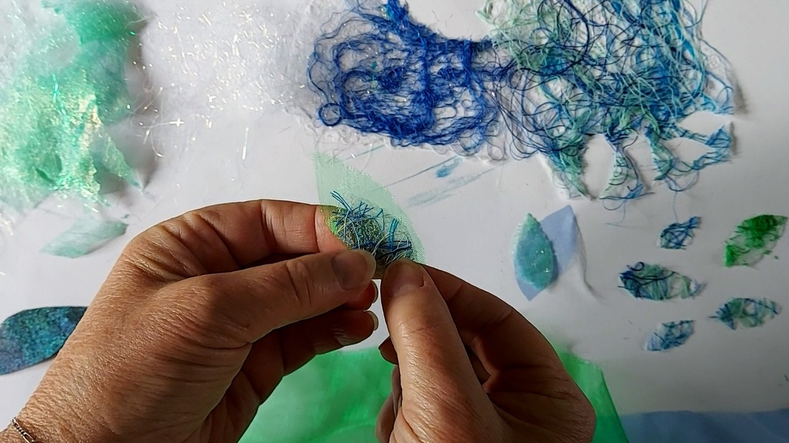
Layer organza and build flowers
STEP 9
Cut organza into small leaves or petals and arrange these with Angelina fibres and threads to build a flower. Place small pieces of bonding web beneath selected areas. Leave other sections unbonded so they can lift away from the surface. Build the design gradually, securing each layer with a protected iron. The loose organza edges create a delicate three-dimensional effect.
TEACHER TIP
Bond only part of each organza shape to create raised texture.

Slide 13
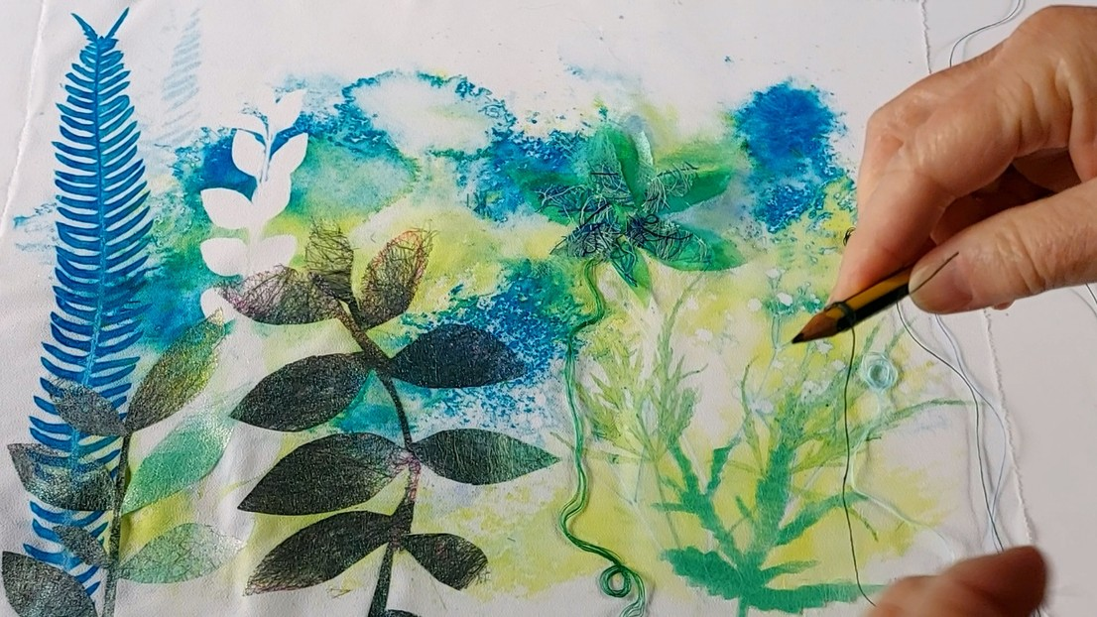
Add the finishing touches
STEP 10
Wrap coloured thread around a pencil several times, leaving a loose end, then slide it off to form a coil. Place small pieces of bonding web beneath the thread circles and arrange them on the artwork. Gently iron the bonded sections to secure the circles while leaving thread ends loose. Try colours that complement your background and appliqué for movement and texture.
TEACHER TIP
Leave some thread ends loose to add movement.

Slide 14
MAKE IT YOUR OWN
Explore new materials.
Build new textures.
Experiment with different leaf shapes
Overlap transfer dye prints
Blend new Angelina fibre colours
Try translucent organza layers
Develop samples into a final artwork
Experiment • combine • develop

